Slide 1
Social Distance Detector

Slide 2
AGENDA
What is social distancing?
How we implement it?
Steps for SDD?
Which object detection technique?
What is blob?
What is NMS?
What is CLI?

Slide 3
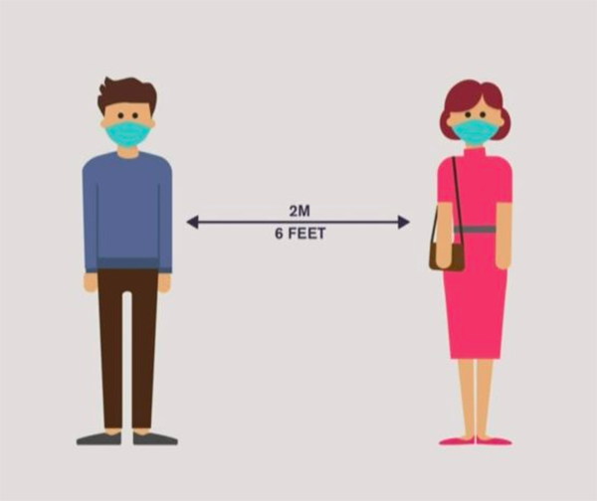
What is Social distancing?
Method used to control the spread of contagious diseases.
Distance themselves from one another, reducing close contact.

Slide 4
How to implement it?
We will be using
OpenCV
Computer vision
Deep learning.

Slide 5
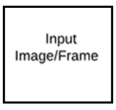
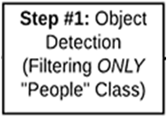



Steps

Slide 6
Which object detection technique?
We encounter three DL based object detection
R-CNN
Single Shot Detector (SDD’s)
YOLO

Slide 7
YOLO
One stage detector strateg
You only look once
Object detection as regression problem
Take the given input image
Learn bounding boxes coordinates
Class label probabilities

Slide 8
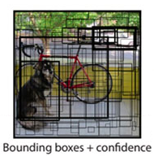
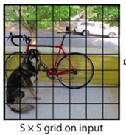
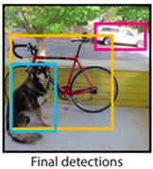
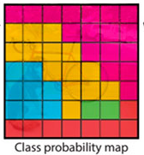
Example

Slide 9
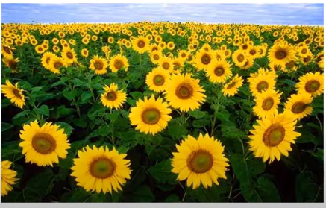
What is blob?
Binary Large Objects
Group of connected pixels in an image that share some common property .
Centroid , color, size etc.
Example:

Slide 10
Operations
Mean Subtraction
Normalization
Channel swapping

Slide 11
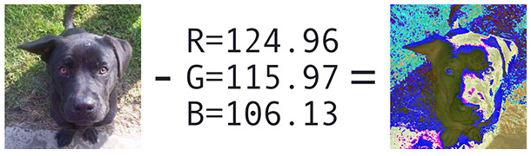

Mean Subtraction
We first compute the average pixel intensity across all images in the training set for each of the Red, Green, and Blue channels.
μR , μG and μB

Slide 12

Normalization
We have a scaling factor, σ

Slide 13
Channel Swapping
OpenCV assumes images are in BGR channel order.
`mean` value assumes we are using RGB order
To resolve this we can swap the R and B channels

Slide 14
NMS
Non – Maxima Suppression
Algorithms to select one entity (e.g. bounding boxes) out of many overlapping entities.

Slide 15
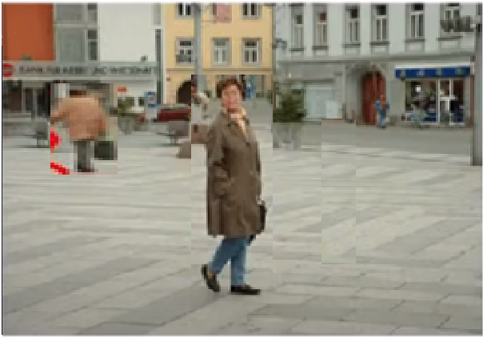



Example:
Confidence score :
how confidence that the detection is correct.
5
12
20
8 6 7 3 4 5 7 2

Slide 16
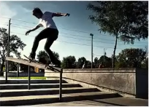
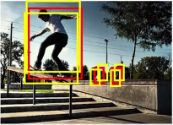
Lets suppose we take Confidence score = >95%
CS = >40%

Slide 17
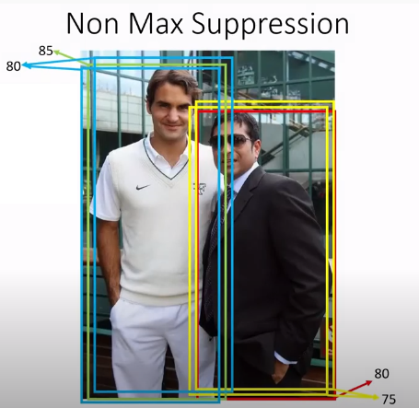
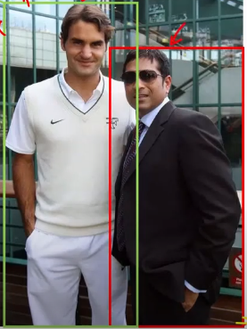
Drawback
It fails when object are closer

Slide 18
CLI
Command Line Argument
flags given to a program/script at runtime.
They contain additional information for our program.
Similarly like a function only

Slide 19
Why CLI?
Computer vision project we have to give lot of image paths or video paths.
How we perform CLI, example:

Slide 20
Where,
op is the ArgumentParser object,
argument i.e shorthand (--n) and longhand(--name) these are used as flag in cmd.
required = True,
help give some additional information about our data.

Slide 21
THANK YOU

Slide 22
Thank You

